Slide 1
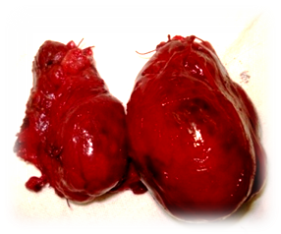
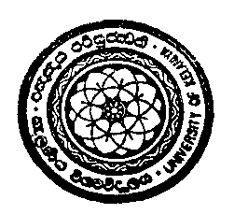
Development , Developmental abnormalities and Surgical Management of Thyroid Diseases
Prof Ranil Fernando
Dept. of Surgery

Slide 2
Development of Thyroid
The thyroid gland is the first of the body's endocrine glands to develop, approximately the 24th day of gestation
The gland originates as a proliferation of endodermal epithelial cells on the median surface of the developing pharyngeal floor
Initial thyroid precursor starts as a simple midline thickening → forms thyroid diverticulum initially hollow later solidifies and becomes bi-lobed
Descent COMPLETE at 7th gestational week

Slide 3
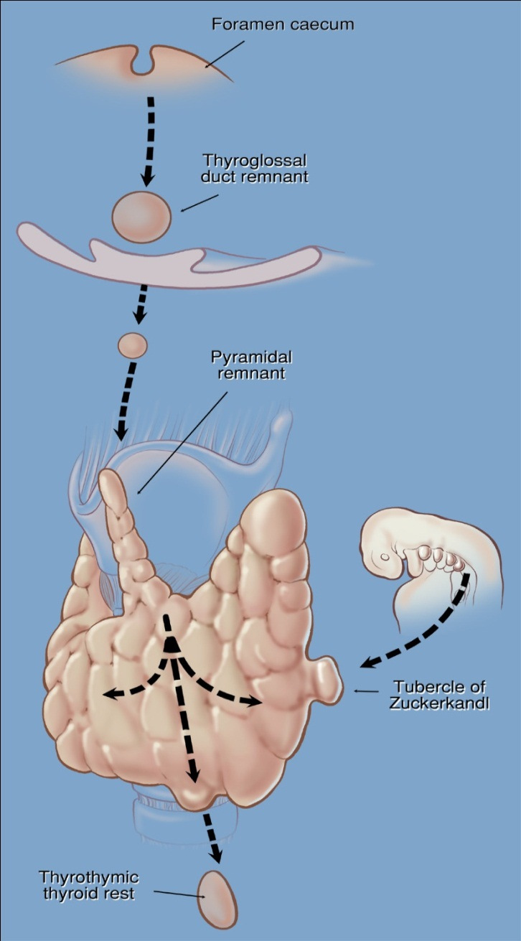
Development of Thyroid
Once developed, the thyroid has 3 main embryological remnants
Thyroglossal tract and the Pyramidal lobe
Tubercle of Zuckerkandl
Thyrothymic Remnants
Descent from the foramen caecum
  Pyramidal remnants
Migration from 4th branchial pouch/ultimobranchial body
  Zuckerkandl remnants
continued descent
  Thyrothymic thyroid remnants
Knowledge of these remnants Critical in
Thyroid Surgery

Slide 4
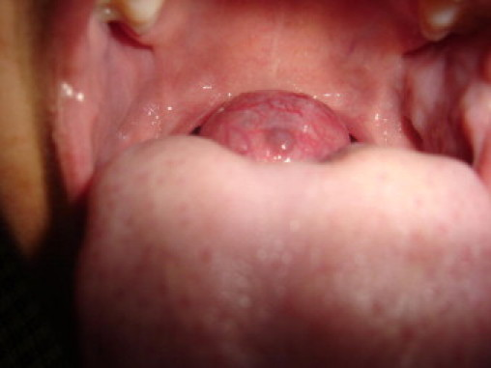
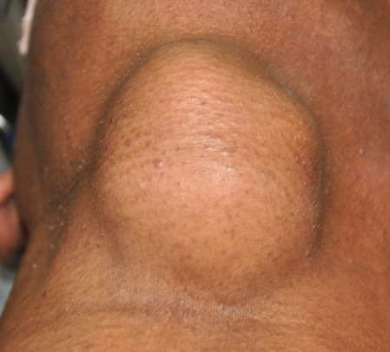
Developmental abnormalities and Surgical Management of Thyroid Diseases
Thyroid descent may be halted and the thyroid may be located at the base of tongue -Lingual thyroid
Remnants of the thyroglossal
tract cause Thyroglossal cysts
/ Fistulae rarely carcinoma
Surgery For Thyroglossal Cyst
- Sistrunk Operation

Slide 5
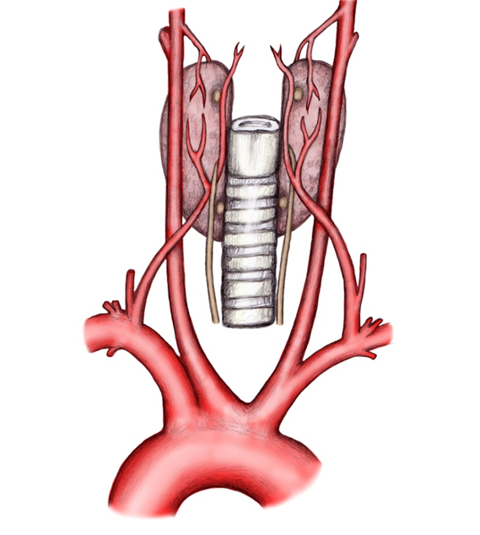
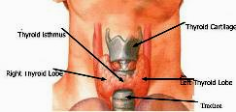
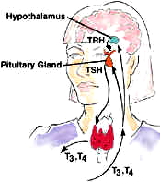

Surgical Management of Thyroid Diseases
Basic Structure & Function of Thyroid
Endocrine gland developmentally
derived from the primitive pharynx
Two lobes joined by an isthmus
Rich blood supply from 4 arteries and
other tributaries
4 nerves and 4 other endocrine
glands are in close Proximity
Produces Thyroxine essential for normal metabolism

Slide 6
Surgical Management of Thyroid Diseases
Why undertake Surgery on the thyroid?
For enlargement – Goitre ( Benign/Malignant)
The 5 Cs of thyroid enlargement
Cosmesis
Compression
Cancer
Control
“Come back” - Recurrence

Slide 7
Surgical Management of Thyroid Diseases
Before surgery, proper assessment
of goitre must be done
3 Main investigations are
(following a full clinical examination)
Thyroid hormone assay ( Function)
US scan ( Morphology)
Fine Needle Cytology ( Pathology)
Patient must be EUTHYROID before surgery

Slide 8
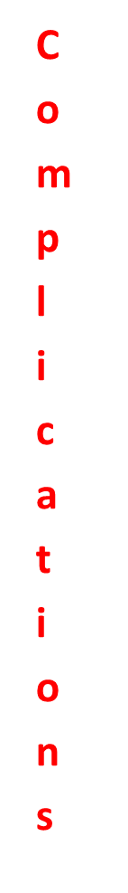
Surgical Management of Thyroid Diseases
History of thyroid surgery
First thyroidectomy is supposed to have been done by
Albucasis (El Zahrawi) in 975 AD
Interest in thyroid disease has not been documented till world
literature the 1100 AD
The Medieval Medical School in Salerno, credited as the birth
place of thyroidology, described various remedies for goitre
around 1180 A.D.
The first well documented total thyroidectomy was
performed by Guillaume Dupuytren in 1808 in Paris
By 1850 14 successful partial or total thyroidectomies had
been reported across Europe
1866 … no honest and sensible surgeon, it seems to me,
would ever undertake thyroidectomy” - Samuel Gross

Slide 9
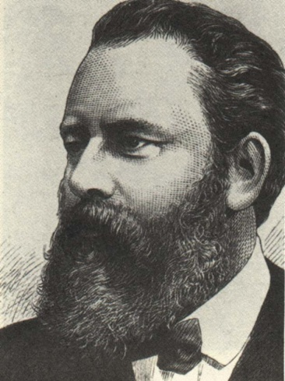
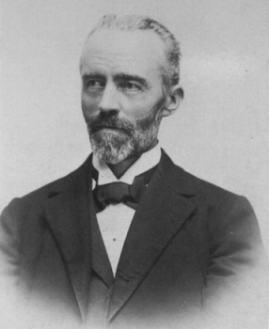
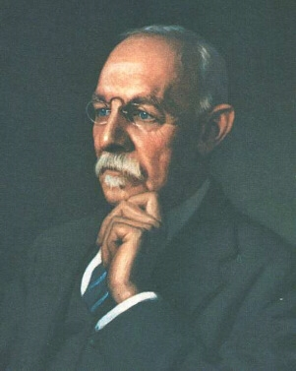
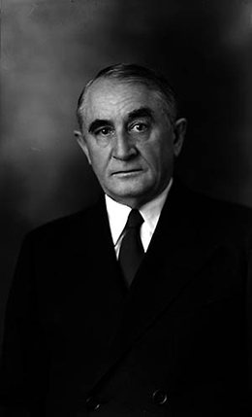
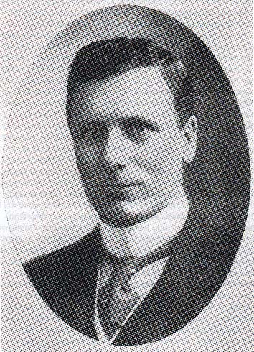
Surgical Management of Thyroid Diseases
Theodor Billroth
Professor of Surgery
Zurich & Vienna 1861 -1877
William Halstead
Professor of Surgery
1852-1922
Johns Hopkins Hospital
Baltimore
Theodor Kocher 1841 -1917
Professor in Berne 1872
Father of thyroid surgery
Thomas Peel Dunhill
1876 - 1957
Australia & UK
,
Charles Horace Mayo
1865 – 1939 – Mayo Clinic

Slide 10
Surgical Management of Thyroid Diseases
Surgery at the turn of the 20th century thyroid
surgery was performed primarily for thyrotoxicosis as it was
the most effective treatment
Fear of complications
  Bleeding
  Injury to nerves ( RLN/ EBSLN)
  Injury to Parathyroid glands
Further development was facilitated by
better understanding of thyroid anatomy & physiology
better understanding of thyroid disorders
better anaesthesia & instruments
Now Surgery is a safe and effective treatment for The 5 CS

Slide 11
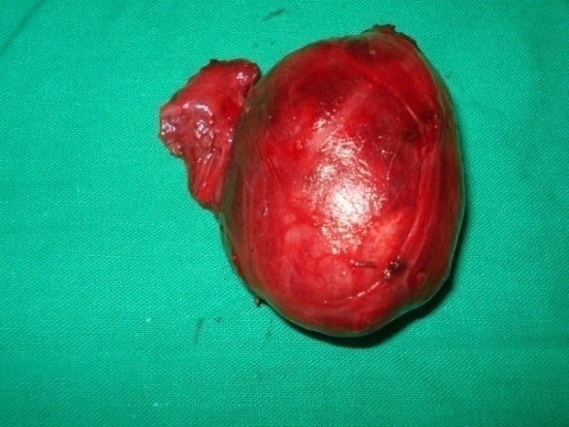
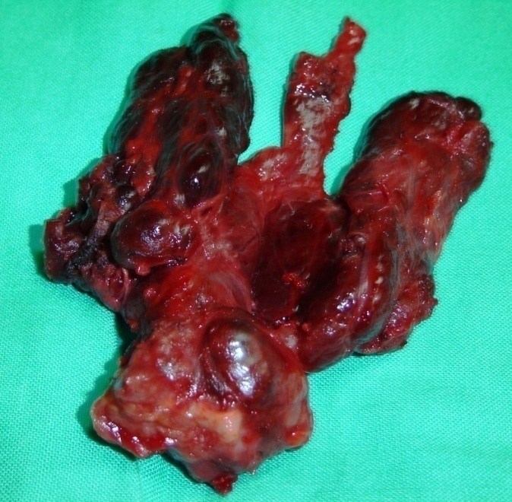
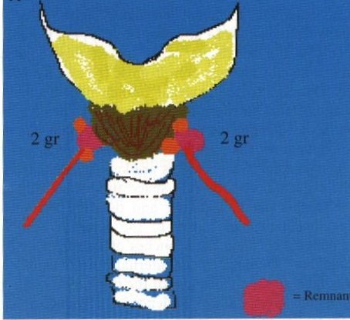
Surgical Management of Thyroid Diseases
Types of Thyroid Operations
Hemi thyroidectomy ( lobectomy)
Total thyroidectomy
Near Total Thyroidectomy
Subtotal Thyroidectomy

Slide 12
Surgical Management of Thyroid Diseases
Surgery for Benign enlargement is the commonest
Endocrine surgical operation world over
Benign enlargement is due mainly to
Multinodular goitre / Colloid goitre
Graves Disease
Thyroiditis

Slide 13
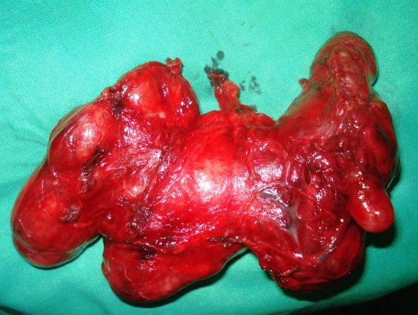
Surgical Management of Thyroid Diseases
Multinodular Goitre
The disease process affects the
WHOLE gland
It is multinodular because
thyrocytes are different. Different clones within the
gland responds to growth stimuli in a variable manner
If a remnant is left behind
    recurrence rate is over 50%
    may develop a cancer
Occult Carcinoma
Current consensus is to do a Total Thyroidectomy
Malcolm Wheeler - Editorial, Lancet 1998;351:1526
Agarwal G, Aggarwal V World J Surgery, 2008 32 (6), 949

Slide 14
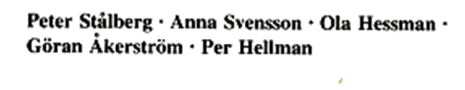

Surgical Management of Thyroid Diseases
Toxic Goitre
Primary - Graves’ Disease
Secondary -Toxic Multinodular goitre -Plummer Disease
Autonomous Toxic nodule
Graves Disease - Mainly managed medically
Surgery - Total thyroidectomy
Eye signs will get worse with subtotal
Toxic MNG - Main treatment is surgery -Total thyroidectomy
Autonomous Toxic nodule - Hemithyroidectomy

Slide 15
Surgical Management of Thyroid Diseases
Thyroid Malignancy
Differentiated Cancers
  Papillary Carcinoma - 75%
  Follicular carcinoma - 15-20% ( Hürthle cell tumour)
Medullary - 6%
Anaplastic - 1- 2%
Primary Thyroid
Lymphomas <1%
Main method of Diagnosis is FNC – Except – Follicular
Medullary Ca & Lymphoma are not “TRUE” thyroid cancers

Slide 16
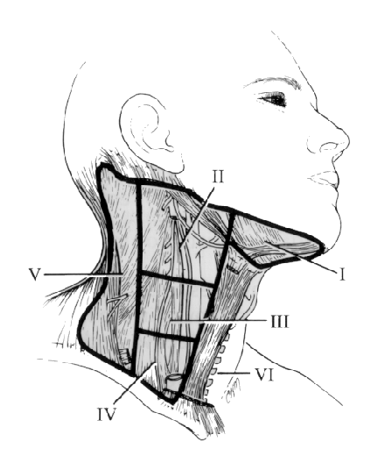
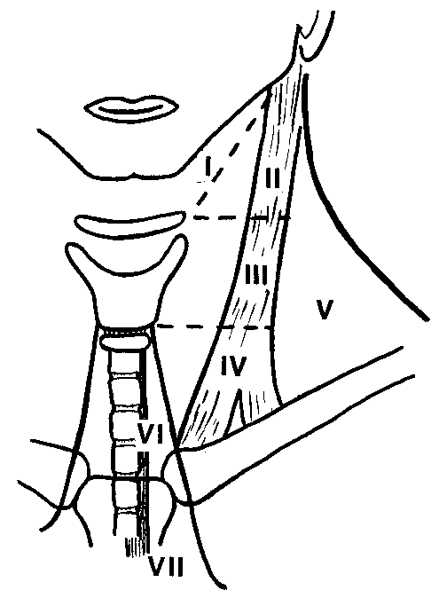
Surgical Management of Thyroid Diseases
Papillary Carcinoma
Multifocal in origin
Metastasis to nodes
Surgery - Total Thyroidectomy
Central node dissection
If nodes are palpable
Selective node dissection

Slide 17
Surgical Management of Thyroid Diseases
Follicular carcinoma
Unifocal in origin
No nodal spread usually
Surgery - Total Thyroidectomy
∴ Both For Papillary & Follicular Carcinoma
Total Thyroidectomy +-
Selective node Dissection
WHY?

Slide 18
Surgical Management of Thyroid Diseases
World J.Surg 2000;24: 942-51
Arguments for Total Thyroidectomy
Total Thyroidectomy is a safe operation in experienced hands
Radio Iodine can be used to detect metastasis
Serum Thyroglobulin level is more sensitive if thyroid is removed
Up to 85% of patients have multiple foci of cancer in other lobes
Recurrence develops in about 10% in the other lobe
50% with recurrences will die from the disease
Re-operative thyroid surgery entails high risk of complications
Recurrence is lower in patients who have undergone total
thyroidectomy
1% risk of residual disease undergoing anaplastic change

Slide 19
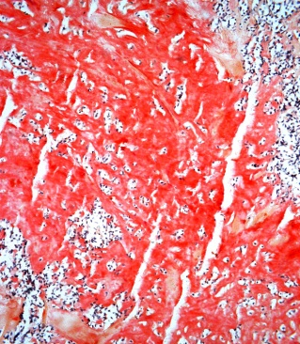
Surgical Management of Thyroid Diseases
Medullary Carcinoma
Arises from parafollicular - C cells which are derivatives of the neural crest - aggressive tumour
First recognized by Hazzard et al from the Cleveland clinic in 1959 in a retrospective review
Has generated much interest due to the Familial form of MTC
C- cell production of Calcitonin is both a useful diagnostic and follow up tumour marker
Surgery - Minimum- Total thyroidectomy central node dissection
It is an aggressive disease and most will need ipsilateral node dissection ? Contra lateral nodes

Slide 20
Surgical Management of Thyroid Diseases
Medullary Carcinoma
MTC arises mainly from the upper poles as the c-cells
aggregate there
Sporadic form occurs mainly in middle aged females
MTC
SMTC
FMTC
MEN II A & B
FMTC

Slide 21
Surgical Management of Thyroid Diseases
MTC
MEN II A & B - Medullary Ca + Phaeochromocytoma
Interesting group of disorders with varying
aggressiveness
MTC usually presents with neck nodes
Detection of mutations in the
RET proto-oncogene in 1993 &1994
has made some interesting developments

Slide 22
Surgical Management of Thyroid Diseases
MTC
Family members of an index patient can be
screened and pre-emptive surgery offered
In II B this has to be done by the age of 2
years and in IIA by 5 years
Elevation of Calcitonin is late
One disease where genetic counseling
offers a possible cure

Slide 23
Surgical Management of Thyroid Diseases
Anaplastic Carcinoma
Most aggressive of the thyroid cancers
Not very common
Advanced on presentation
No effective treatment is available
Drugs that can redifferniate thyroid cancer are
being tested - may offer hope
5 year survival is rare

Slide 24
Surgical Management of Thyroid Diseases
Thyroid Lymphoma
Uncommon tumour - less than 2% of thyroid
malignancies - most are B cell Non Hodgkin Lymphomas
70% are MALT ( Mucosa associated) Lymphomas
Associated Hashimoto’s Disease is a common finding
It’s significance in not known. It is more likely to be
incidental
Clinical presentation may simulate Anaplastic Ca
Common in women in there 70s. Men under 40
also may be affected- causes compression
Tru - cut for diagnosis , Staging must precede treatment
Chemo with CHOP (Cyclo, Doxorubicin ,
Vincristine & Pred) & local irradiation are the main stay

Slide 25
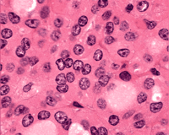
Surgical Management of Thyroid Diseases
Hürthle cell tumour
What is a Hürthle cell tumour ?
Hürthle cell tumours are diagnosed when more
than 75% of a lesion is composed of Hürthle cells
Hürthle cell
(Ashkenazy cell)
A Thyroglobulin
Producing thyroid
cell
Acidophilic granular
cytoplasm
Treatment - like a differentiated cancer

Slide 26
Surgical Management of Thyroid Diseases
Post Operatively
Differentiated Cancers
Obtain Histology report – assess High risk Low risk
Obtain serum Thyroglobulin Level 6 weeks after surgery
Discuss with Oncologist
Map out residual disease with I ¹³¹ Scan
Decide on I¹³¹ or other therapy
Medullary Carcinoma
Most will require further ( adjuvant) therapy
Monitor with Calcitonin Level

Slide 27
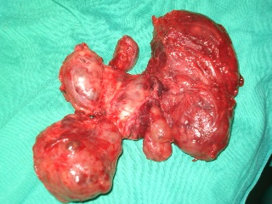
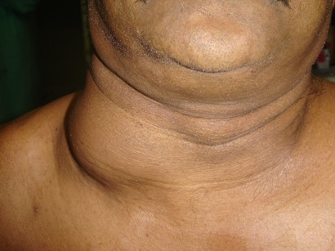


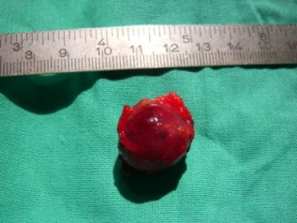
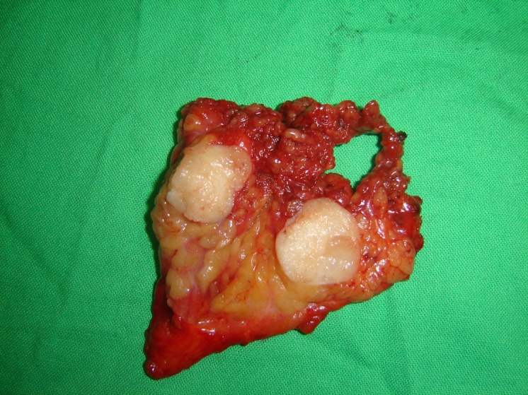
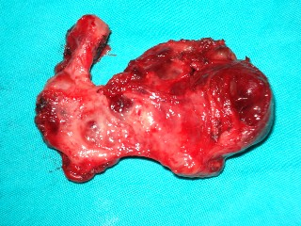
Surgical Management of Thyroid Diseases
Various Types of Goitres
Operated

